Slide 1
Noise Suppression in Ultrasound Beamforming Using Convolutional Neural Networks
Zhanwen Chen
November 11, 2019, 10:00AM

Slide 2
Diagnostic Medical Ultrasound
Notes:
I will start off my presentation by introducing the research domain – diagnostic medical ultrasound. Ultrasound is a portable, affordable, and real-time imaging modality that can provide a cross-sectional view of soft tissues. Shown here is a brightness-mode, or B-mode, image of a cross-section view of the liver of a healthy 37-year-old male. B-mode images like this one characterizes the acoustic impedance of a two-dimensional tissue cross-sections in grayscale. The circled region in the image is a region of the liver and inside the polygonal hightlight is segment of a blood vessel cutting through the field of view. Another notable feature is the presence of speckles which are caused by mutual intereference of waves. They can be features or noises at the same time. For our purposes, we want to preserve them because they could indicate important features which may be removed in a speckle-reduction algorithm. The power of blood scattering is much less than the power of tissue scattering so we expect that blood vessels to be very hypoechoic (solid) or even appearing anechoic (so dense that it is echo-free). That means that there's little to no scattering inside the vessel.

Slide 3

Ultrasound Basic Principles: 1. Transducer
Notes:
Ultrasound relies on two basic principles. The first one is the piezoelectric effect, which describes the ability for certain materials to convert mechanical stress into electrical charge and vice versa. In our case, the mechanical stress is the acoustic pressure from acoustic pulses or waves, and we call this device a transducer. Our raw data is measured in electrical pressure, so in volts.

Slide 4
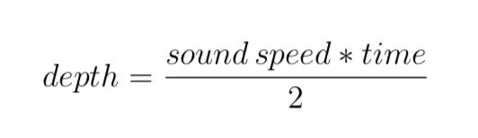
Ultrasound Basic Principles: 2. Pulse-Echo
Notes:
Ultrasound also depends on the pulse echo principle. Sound or acoustic pulses are echoed back and because we know the sound speed in advance and the elapsed time, we can calculate the distance between the origin and the reflection after accounting for both directions.

Slide 5
Ultrasound Beamforming: Transmit (1)
Notes:
In practice, we use a probe which consists of an array transducer made up of many transducer elements. For example, the probe we use which is pictured here has 128 elements in total. Another system is used to control the various parameters of the transmission including frequency and timing. It is also used to access the received data described later.

Slide 6
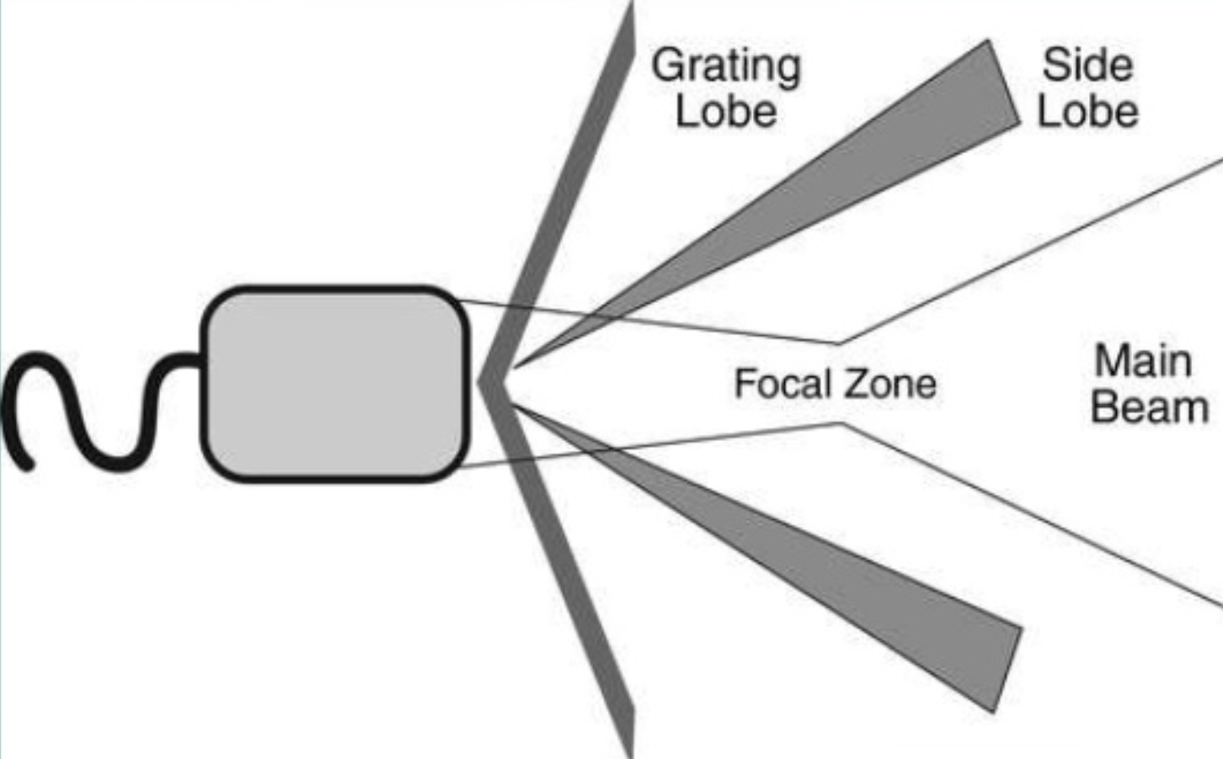
Ultrasound Beamforming: Transmit (2)
Beam
Notes:
Ultrasound beamforming is the application of focus to spatially filter the region in the field of view. The intuition is that we can direct the energy toward this focal region so as to increase the signal coming back from the region relative to the rest. The location of the focus is a parameter we can adjust.

Slide 7
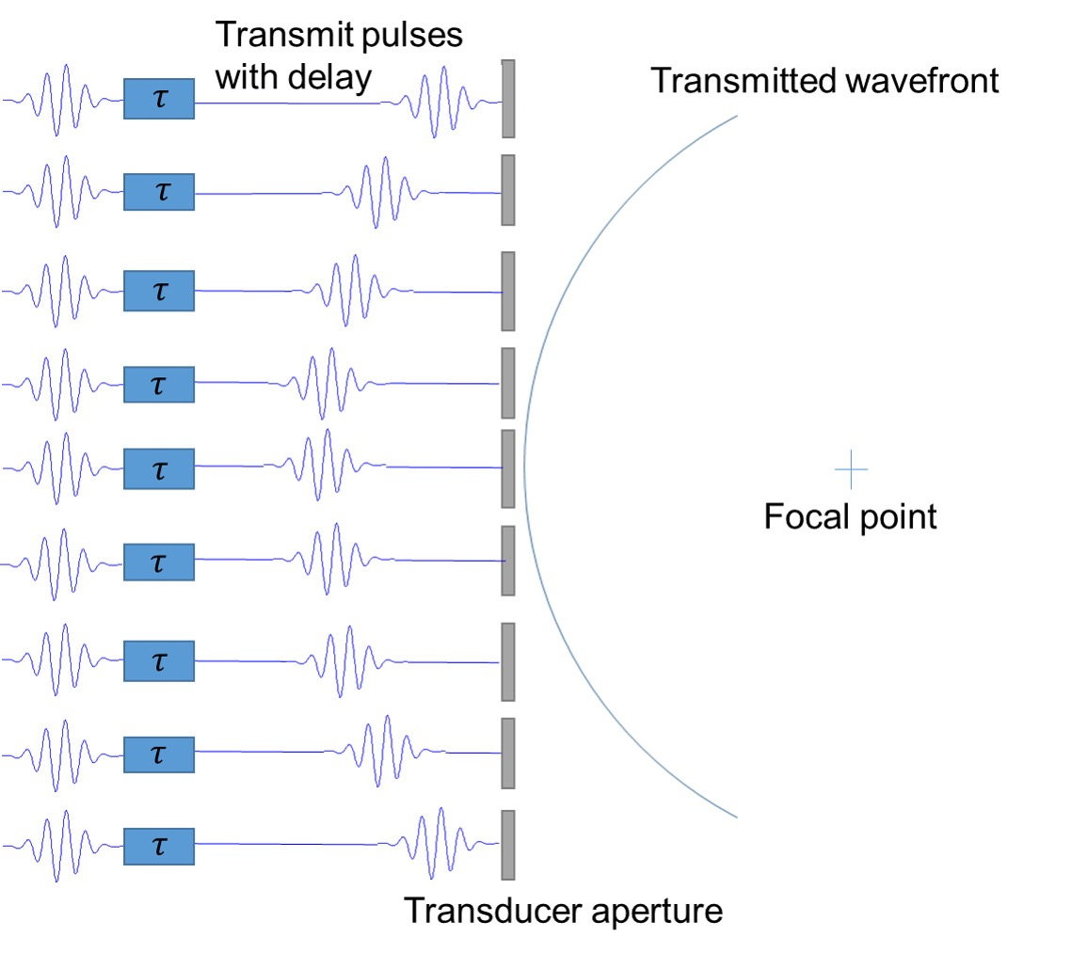
Ultrasound Beamforming: Transmit (3)
Notes:
To introduce focus, we apply time delays to pulses emitted each element in a beam using a Pythagorean-like formula given the location of the focal point a priori. This way, we alter the overall shape of the wavefront of the pulses to curve towards the focus.

Slide 8
Ultrasound Beamforming: Transmit
128 elements
1st beam, 65 elements
Center element
Notes:
To do this, we use many subset of a probe, each scanning a vertical sliver of the image. In practice, we select a subset of elements from the transducer to form a beam.

Slide 9
Ultrasound Beamforming: Transmit
128 elements
2nd beam, 65 elements
Center element

Slide 10
Ultrasound Beamforming: Transmit
128 elements
3rd beam, 65 elements
Center element
Notes:
In practice, we select a subset of elements from the transducer to form a beam.

Slide 11
Ultrasound Beamforming: Transmit
128 elements
4th beam, 65 elements
Center element
Notes:
In practice, we select a subset of elements from the transducer to form a beam.

Slide 12
Ultrasound Beamforming: Transmit
128 elements
5th beam, 65 elements
Center element
Notes:
In practice, we select a subset of elements from the transducer to form a beam.

Slide 13
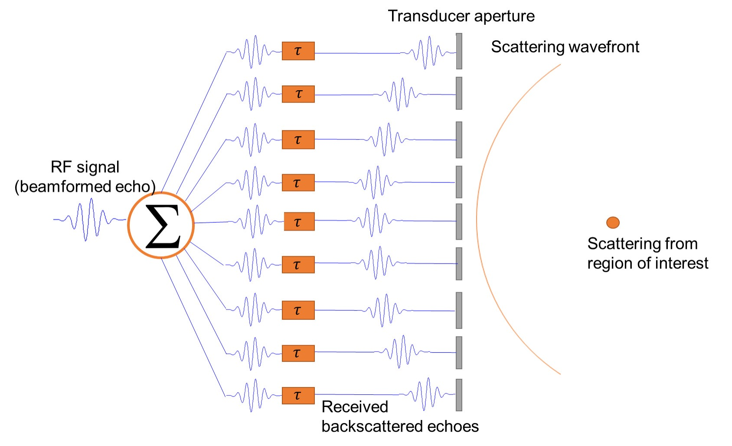
Receive: Delay-and-Sum Beamforming
Notes:
Delay-and-Sum (DAS) beamforming is the most basic beamforming method. It simply subtracts the time delays for each channel so that the curved return wavefront becomes flat. This is to

Slide 14
Receive: Delay-and-Sum Beamforming
Envelope Extraction, Log Compression
Apply Delays
Sum Across Channels
Channel Data
Post-delayed Channel Data
Beamformed RF Data
Image
num_times=1624
x num_channels=65
x num_beams=128
num_times=1624
x num_channels=65
x num_beams=128
num_times=1624
x num_beams=128
num_times=1624
x num_beams=128
Notes:
Create an animation.
Delay-and-Sum (DAS) beamforming is the most basic beamforming method. It simply subtracts the time delays for each channel so that the curved return wavefront becomes flat. This is to
The received radio frequency (RF) data is called channel data.

Slide 15
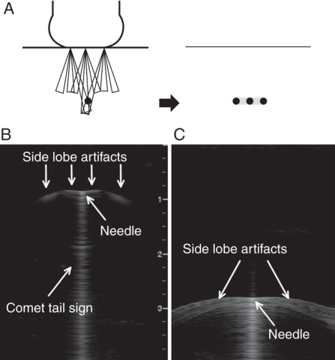
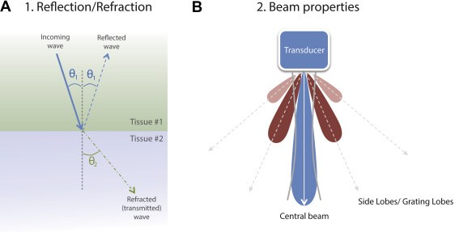
Issue: Side Lobe Artifacts
Notes:
However, there are many artifacts that can appear due to unexpected acoustics pattern. One such issue is side lobe artifacts, or off-axis scattering. We rely on the central beam to focus our acoustic energy, but energy could spill over on the side. One analogy is that water spills on the side of a garden hose.

Slide 16
Motivation/Related Work: 1. Classic Approaches
Short-Lag Spatial Coherence
Use a coherence measure for each channel instead of dB.
Con: Slow.
Coherence Factor
Post-process; compute a weight for each beam based on coherence ratio.
Pro: Fast.
Con: Poor dynamic range because it makes everything look anechoic; lower CNR due to speckle destruction.
Minimum-Variance Beamforming
Minimize the power of off-axis regions, while preserving the power of the target region (a point location)
Pro: works well on phantom
Con: does not work well on in vivo due to dB variation from the inside region.

Slide 17
Motivation/Related Work: 2. Machine Learning Approaches
ADMIRE (regression)
Pro: Great performance
Con: Slow. Not real time.

Slide 18
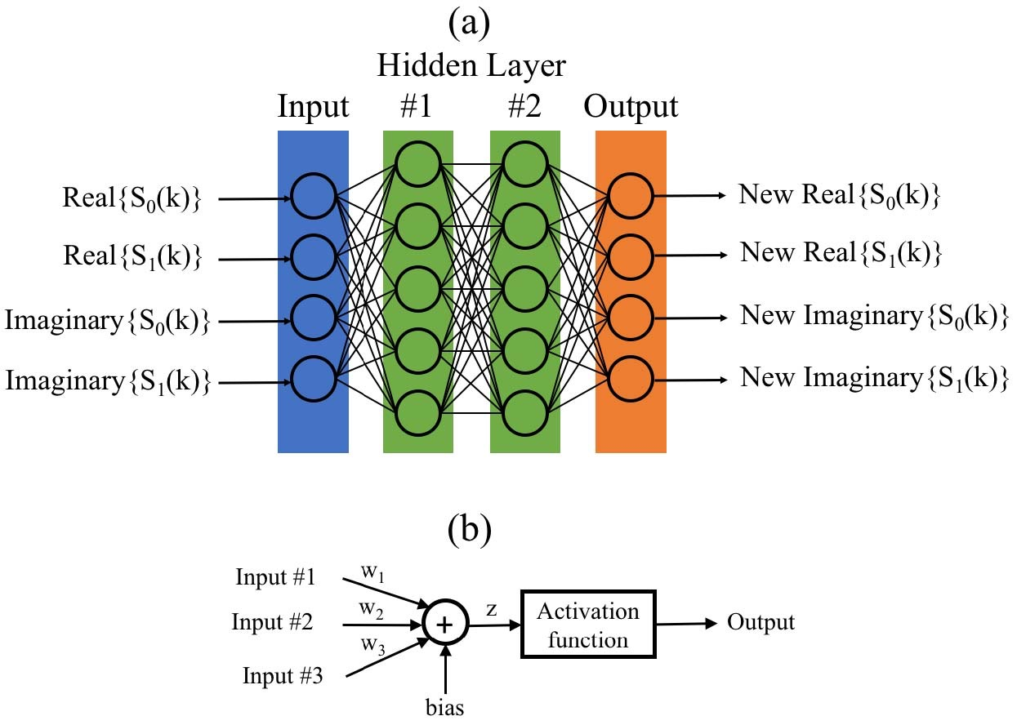
Other Approach: Frequency-Domain MLP
Notes:
Pros: 1. Great performance. 2. Fast. Could be real time. Is also my approach. Are there spatial features to be learned?

Slide 19
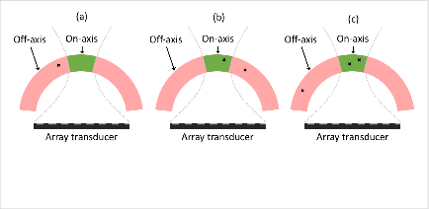
Simulate Training Data
Notes:
100,000 training examples, 10,000 validation examples.

Slide 20
Neural-Network Beamforming
Channel Data
Apply Delays
Post-delayed Channel Data
STFT
Frequency-Domain Data
NN
Denoised Frequency-Domain Data
num_times=1624
x num_channels=65
x num_beams=128
num_times=1624
x num_channels=65
x num_beams=128
num_frequencies=16
x num_segments=805
x num_channels=65
x num_beams=128
num_frequencies=16
x num_segments=805
x num_channels=65
x num_beams=128
iSTFT
Image
Beamformed RF Data
Denoised Channel Data
num_times=1624
x num_channels=65
x num_beams=128
Envelope Extraction, Log Compression
Sum Across Channels
num_depths=1624
x num_beams=128
num_depths=1624
x num_beams=128

Slide 21
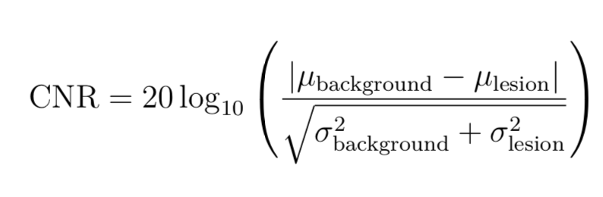
Metric 1: Contrast-to-Noise Ratio (CNR)
Notes:
μ is the mean and σ is the standard deviation of the uncompressed envelope. The CNR is a measure of the normalized difference between average signal intensity.

Slide 22
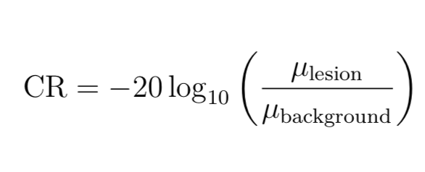
Metric 2: Contrast Ratio (CR)
Notes:
μ is the mean and σ is the standard deviation of the uncompressed envelope

Slide 23
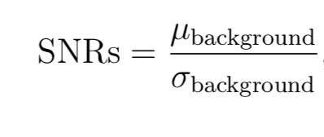
Metrics 3: Speckle SNR
Notes:
μ is the mean and σ is the standard deviation of the uncompressed envelope. It measures the quality or the variance of speckles and ideally we want our speckles to be in a reasonable range like 1.9.

Slide 24
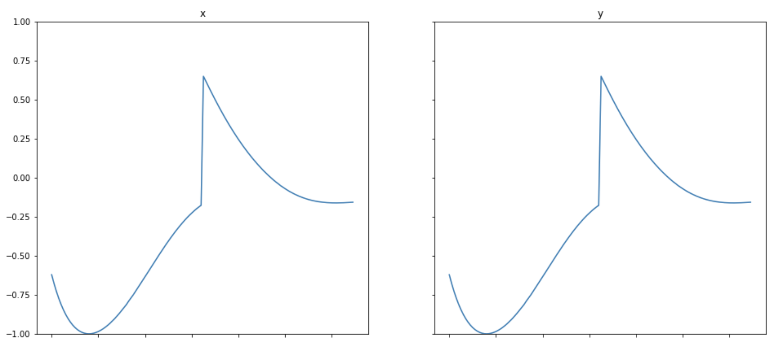
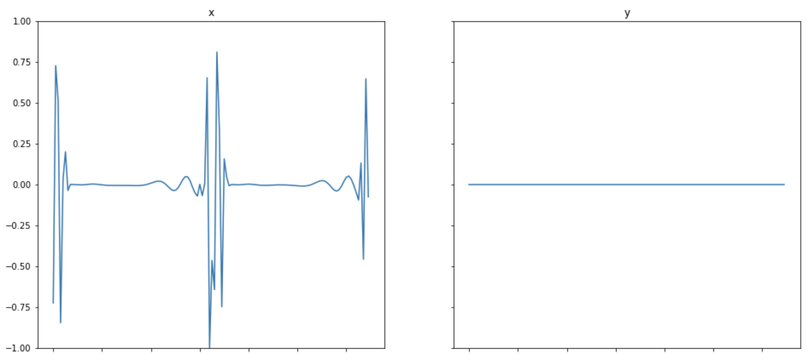
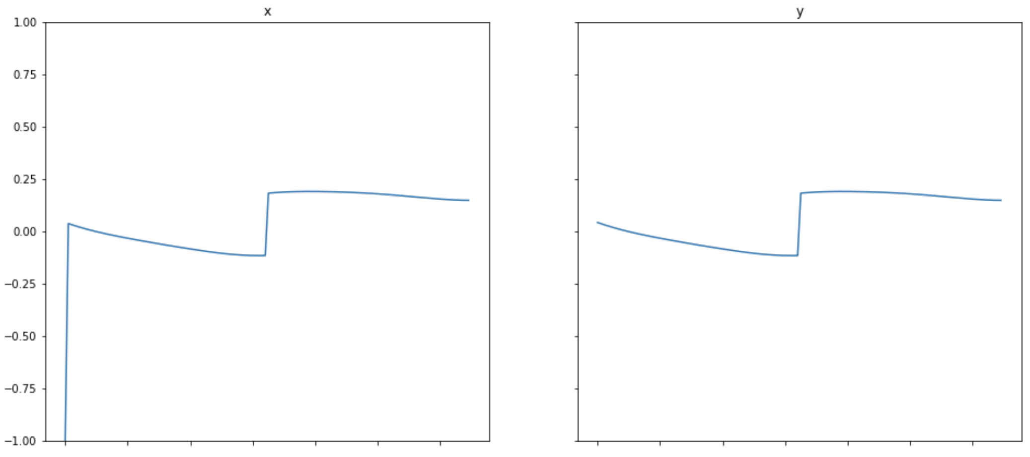
Training Data: Three Modes
Accept
Reject
Mixed-Smooth

Slide 25
Input Groupings
Notes:
The

Slide 26
CNN Arch 1: “LeNet”
Convolutions
Full connection
Full connection
Convolutions

Slide 27
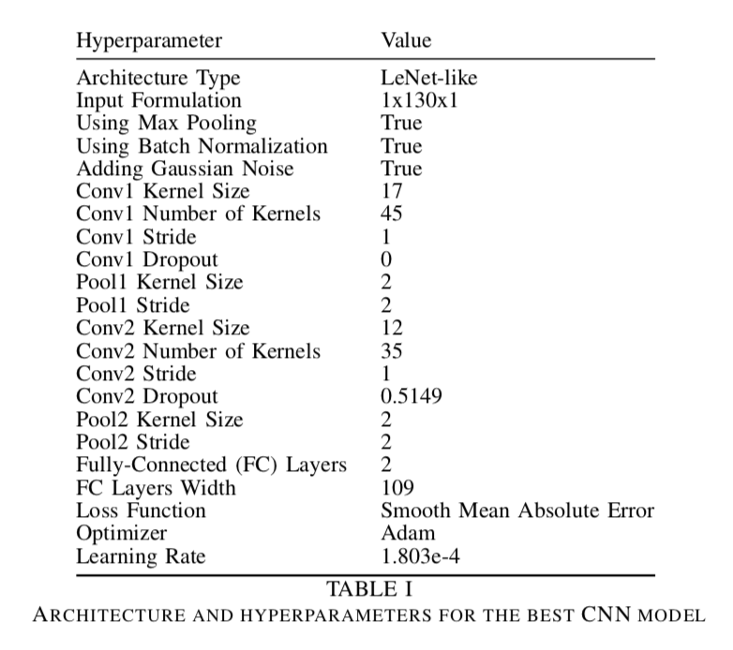
Results: DAS < LeNet ≈ MLP

Slide 28
Results: DAS < LeNet ≈ MLP
For a phantom target, DAS has a CNR of 4.24, MLP 5.57, and LeNet 5.46 dB.

Slide 29
In Vivo Results: DAS < LeNet ≈ MLP
For an in vivo target DAS has a CNR of -14.98, MLP 0.80, and LeNet -2.84 dB.
Notes:
Generalization yes.

Slide 30
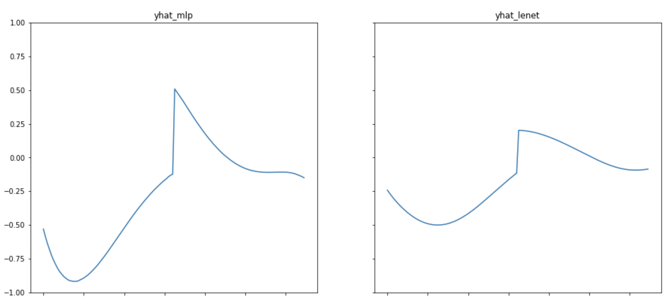
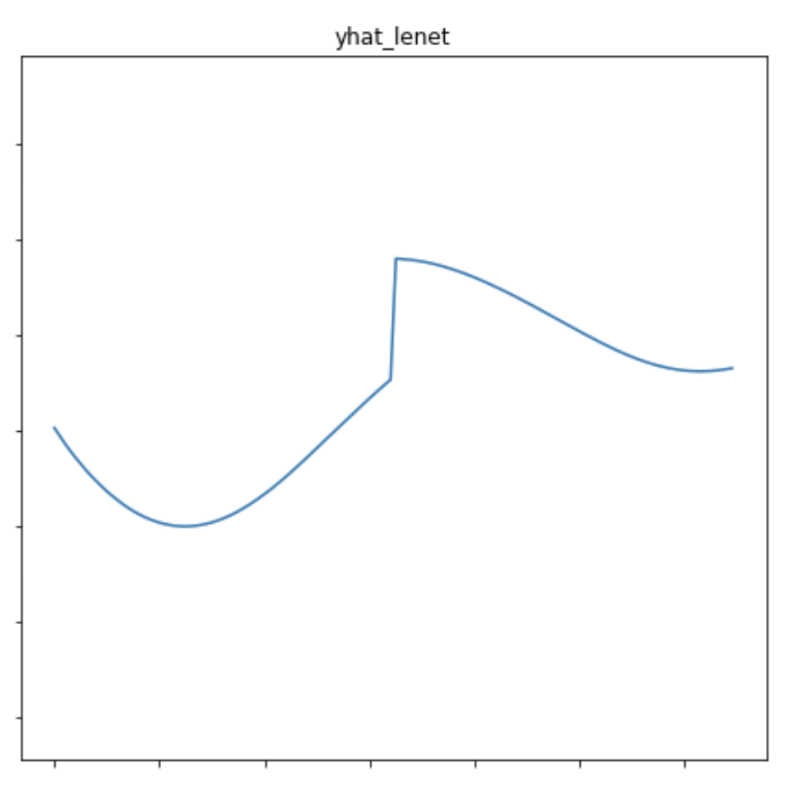
Input-Output Analysis: Training, Accept Case

Slide 31
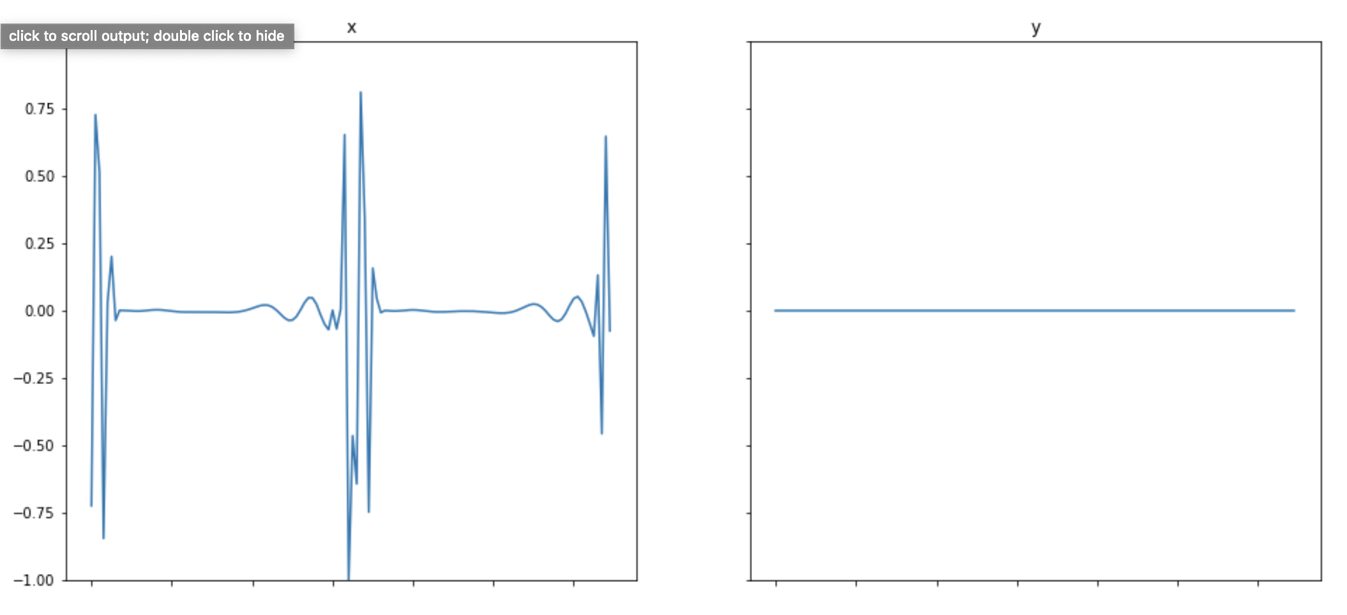
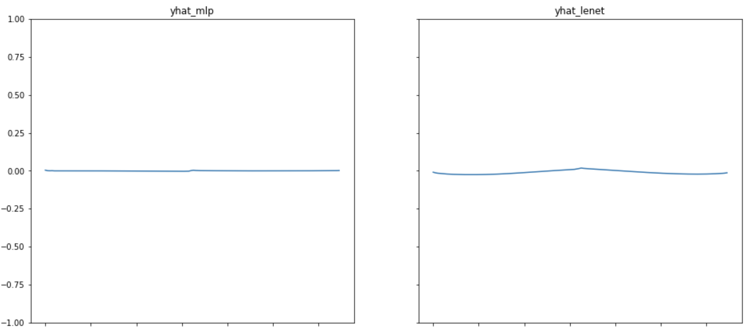
Input-Output Analysis: Training, Reject Case

Slide 32
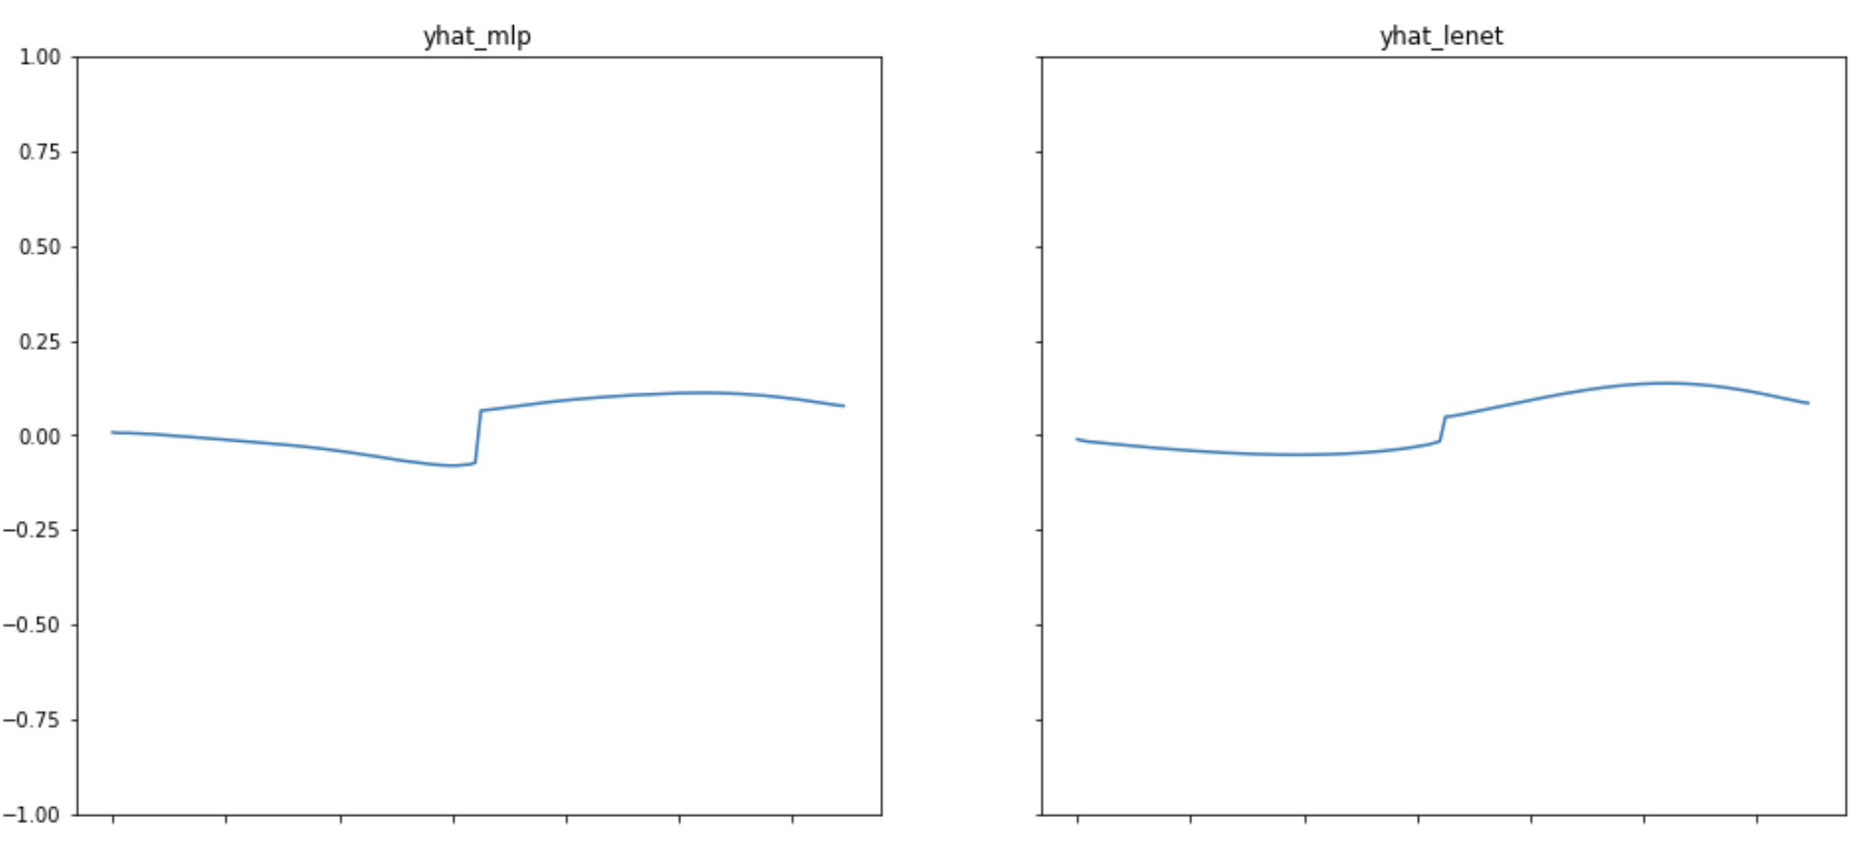
Input-Output Analysis: Training, Mixed Case

Slide 33
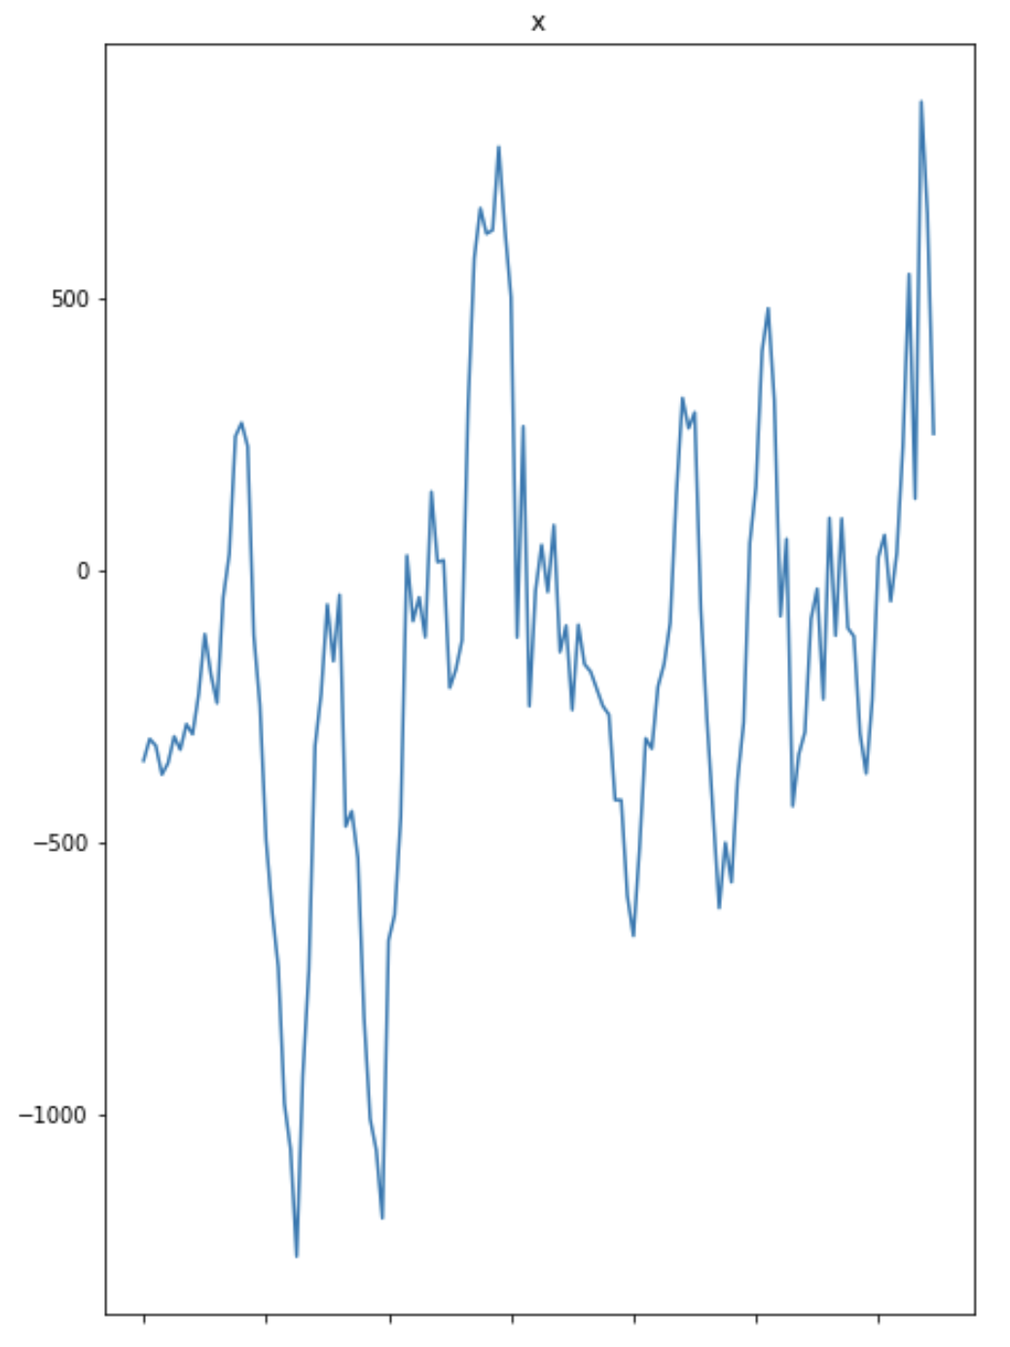
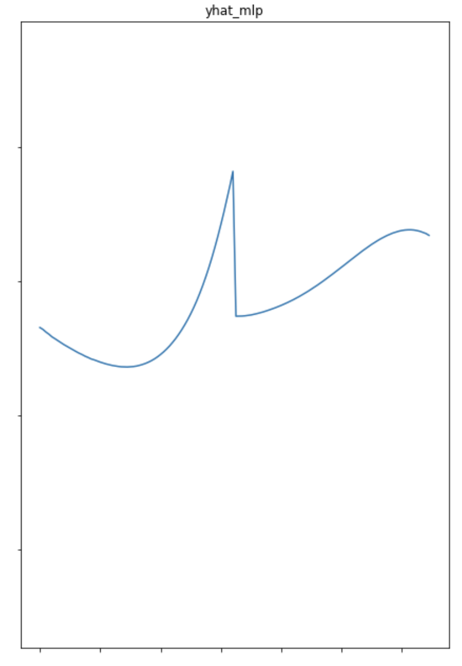
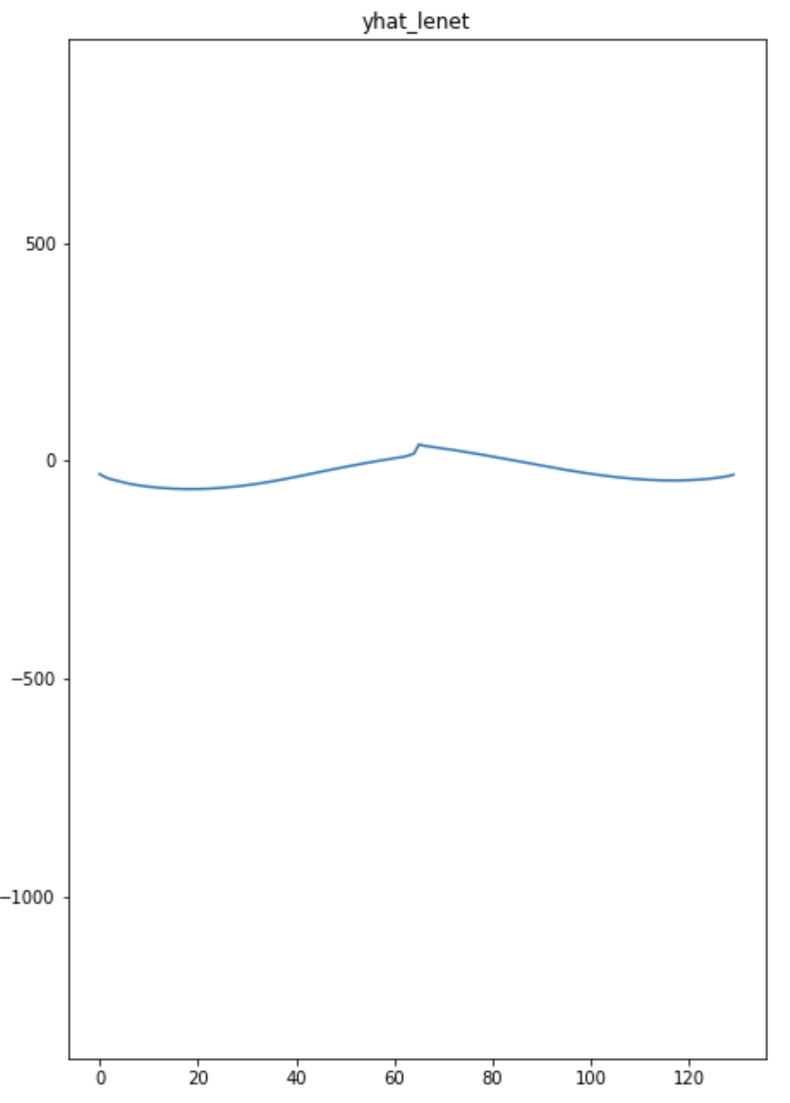
Input-Output Analysis: Test, Mixed Case
Notes:
It’s not easy to explore the test data and most are mixed signals.

Slide 34
Challenges 1: Train/Test Domain Mismatch
Train (train/validation for ML loss) is from simulation.
Test (phantom and in vivo) are from physical scans.
Notes:
Generalizability between training and test.

Slide 35
Challenges 2: Learning Objective Mismatch
Frequency-domain simulation training and validation loss are not used for model selection. Not beamformable.
Beamformed test data (image domain, CNR) are used for model selection.
Notes:
Objective for the learning task: not to lower loss, but to maximize CNR which depends.

Slide 36
CNR vs. Number of Weights. LeNet More Robust?

Slide 37
CNN Arch 2: Fully-Convolutional Networks (FCN-4)
Input Size == Output Size
Conv2
Up1 + Conv3
Conv1
Up2 + Conv4
Notes:
To answer the question of “does convolution really help?” We tried a new architecture.

Slide 38
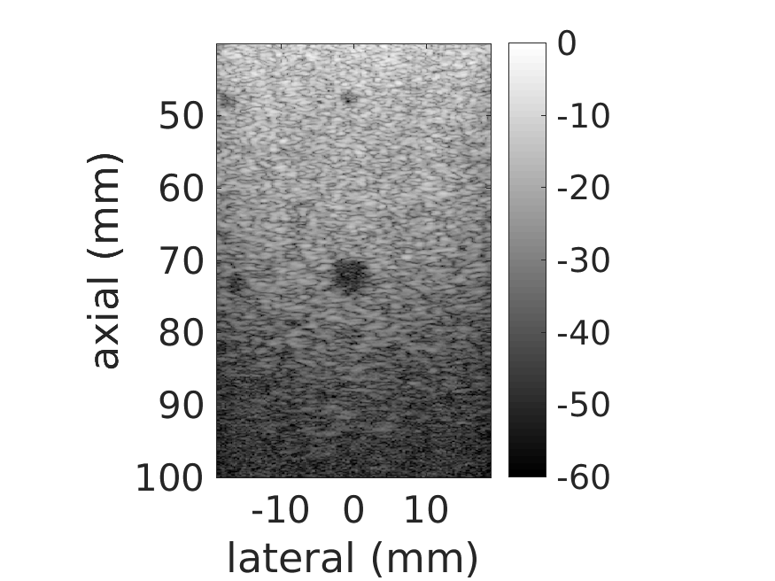
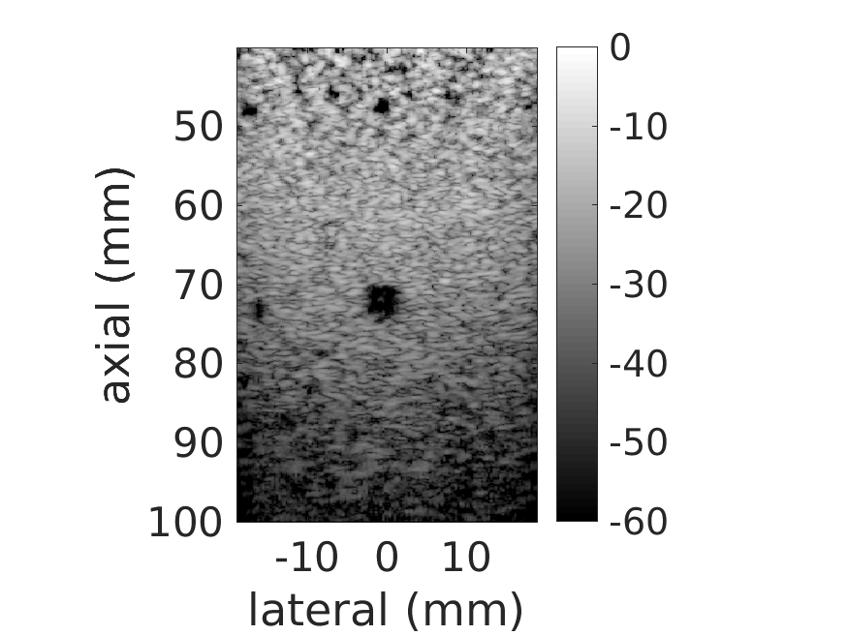
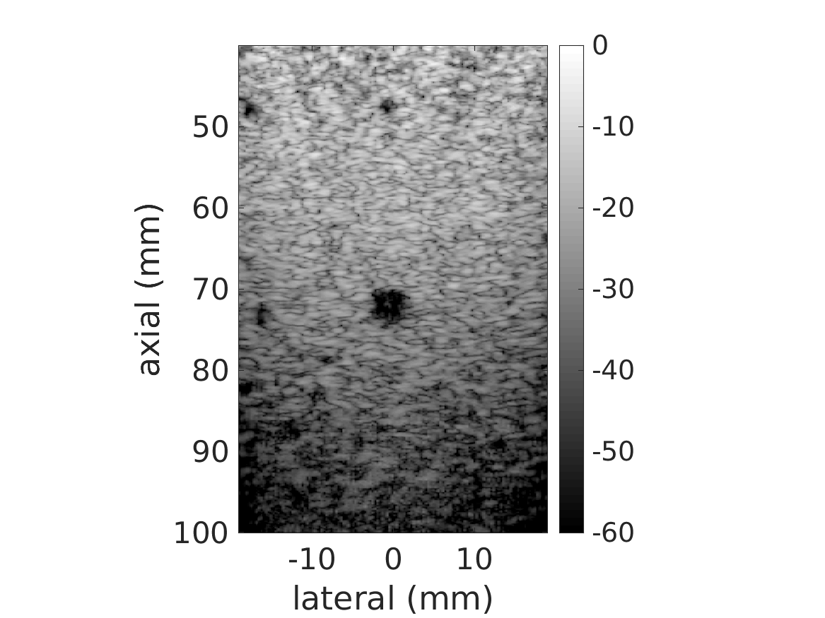
Results: DAS < FCN-4 < LeNet ≈ MLP
DAS
MLP
LeNet
FCN-4
1cm
For a phantom target, DAS has a CNR of 4.24, MLP 5.57, LeNet 5.46, and FCN-4 4.98dB.

Slide 39
In Vivo Results: DAS < FCN-4 < LeNet ≈ MLP
DAS
MLP
LeNet
FCN-4
1cm
For an in vivo target DAS has a CNR of -14.98, MLP 0.80, LeNet -2.84, and FCN-4 -3.79dB.
Notes:
Generalization yes.

Slide 40
Results: DAS < FCN-4 < LeNet < MLP
MLP: Best Phantom CNR: 5.54
LeNet: 5.29
FCN-4: 5.09
DAS: 4.40

Slide 41
The Effective Receptive Field of Convolution
Input
Output
Effective Receptive Field = 3

Slide 42
The Effective Receptive Field of Convolution
Input
Output
Effective Receptive Field = 5

Slide 43
The Effective Receptive Field of Convolution
Input
Output
Effective Receptive Field = 7 == input

Slide 44
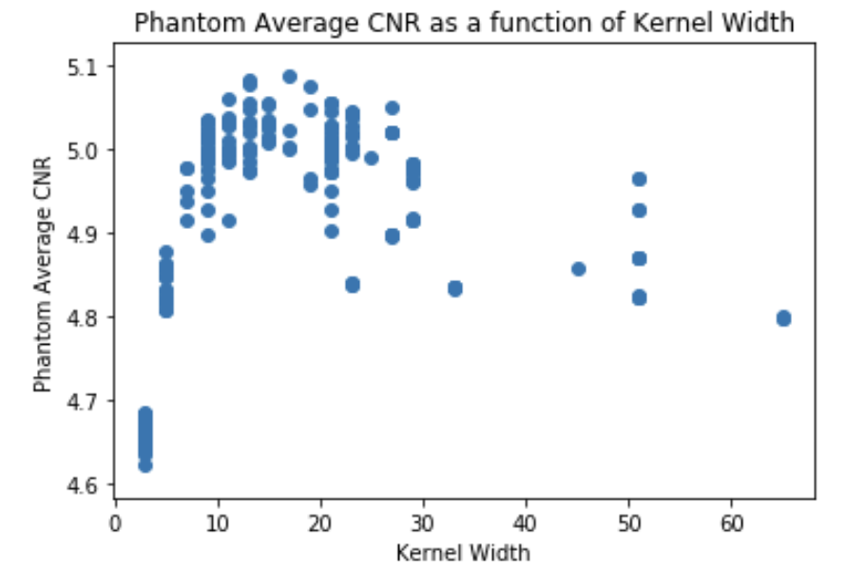
Are Convolutions Helpful? 1. CNR vs. Kernel Size
Notes:
It doesn’t seem like the case, although the larger kernels are under sampled.

Slide 45
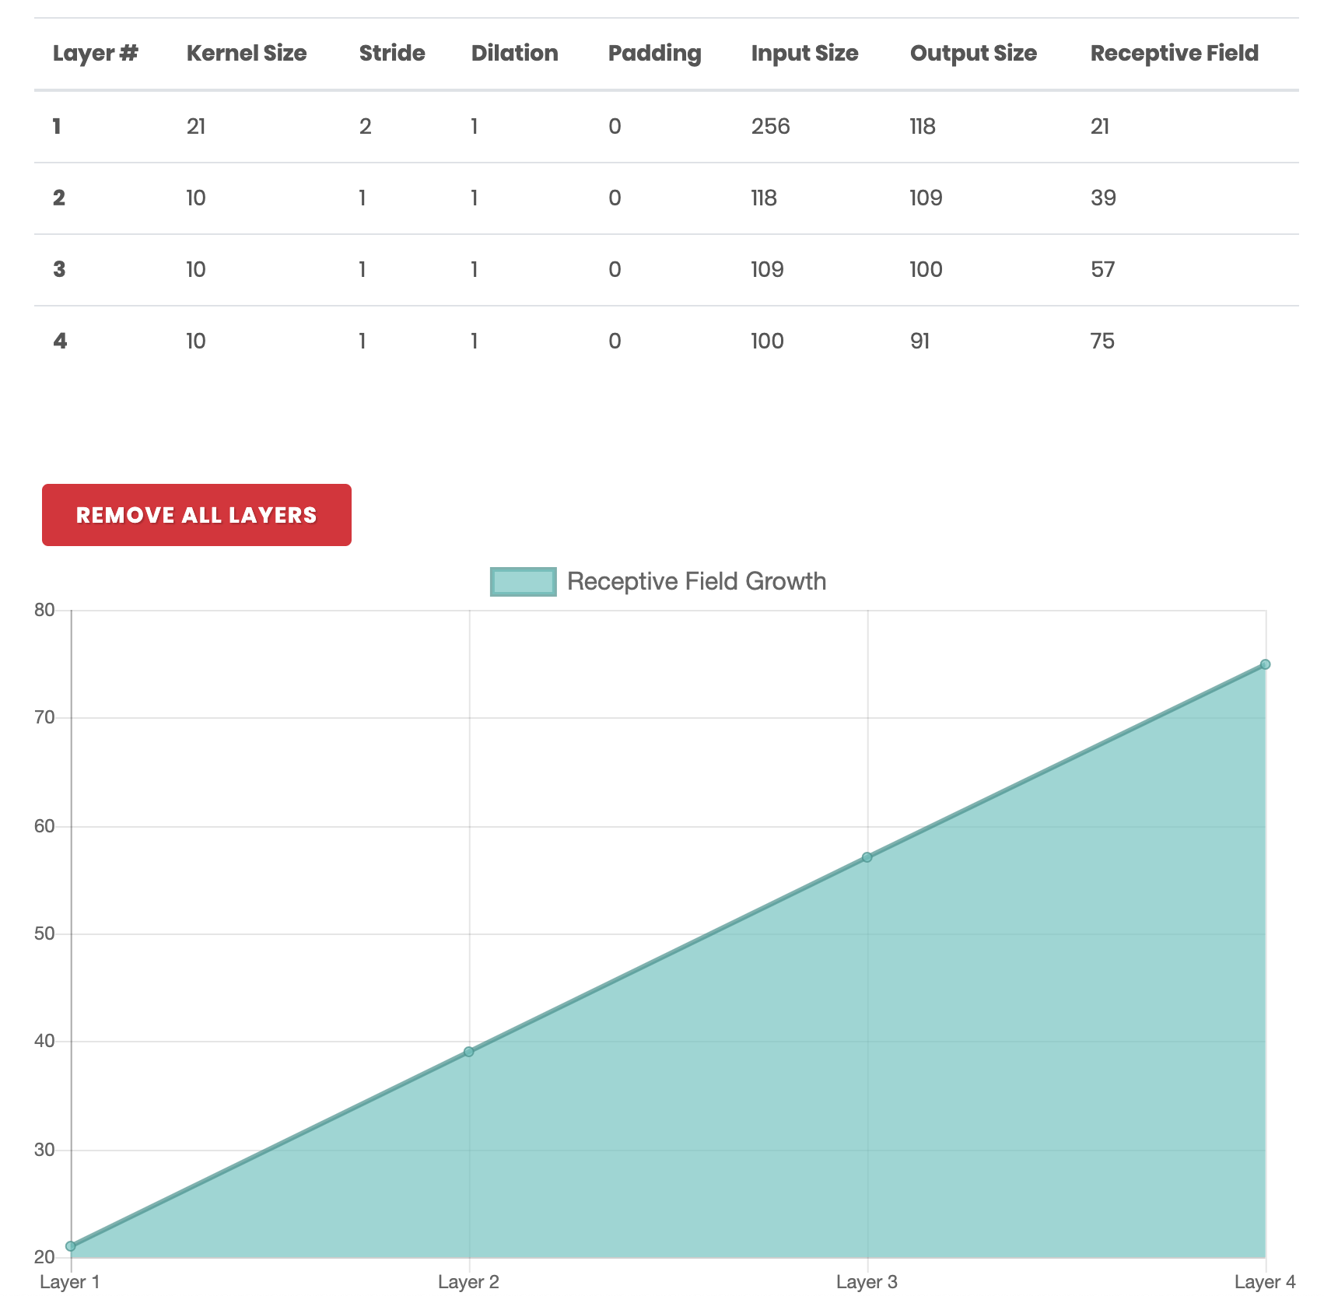
FCN-4’s Receptive Field Size
Notes:
At kernel size = 17, it is the best, possibly because it just starts to cover almost all of input. At kernel size = 21 does the receptive field completely cover the input.

Slide 46
The Effective Receptive Field of Convolution
Input
Output
Effective Receptive Field = 5

Slide 47
The Effective Receptive Field of Convolution
Input
Output
Effective Receptive Field = 7 == input
Notes:
Using smaller convolutional kernels, can we improve the performance by just using more convolutional layers?

Slide 48
Method for Finding CNN: Constraint-Satisfaction of Layers
Width_{out} = (Width_{in} – Width_{kernel} + 2 * Width_{pad} ) / W_{stride} + 1
Find a set of (kernel size, padding size, and stride size) for each convolutional layer such that
The final output has the same resolution as input.

Slide 49
Conclusions and Future Work
Research Contribution
Investigated the role of convolution.
Compare LeNets with FCNs – shallow FCNs do not seem to perform better than LeNets.
Studied the role of kernel sizes – the ideal kernel size makes the receptive field approximate the input size
Future work
Vary the number of kernels for each convolutional layer.
Vary the number of convolutional layers.
Vary the bottleneck size of MLPs to extract features that generalize better.
Notes:
And Bottleneck

